Slide 1
PERT, CPM and Float

Slide 2
Critical Path calculation
To find the critical path for a project, you must first develop a good network diagram which in turn requires a good activity list based on the WBS.
Once you create a network diagram, you must also estimate the duration of each activity to determine the critical path.
Calculating the critical path involves adding the durations for all activities on each path through the network diagram. The longest path is the critical path.

Slide 3
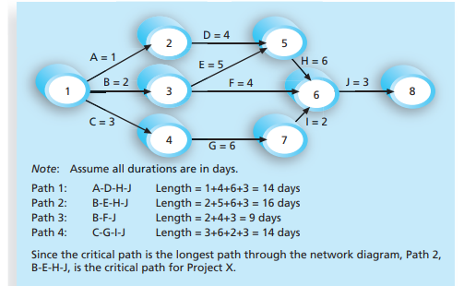

Slide 4
What does the critical path really mean? Even though the critical path is the longest path, it also represents the shortest time required to complete a project.
If one or more activities on the critical path take longer time than planned, the whole project schedule will slip unless the project manager takes corrective action.
Project teams can be creative in managing the critical path.

Slide 5
PERT
When there is a high degree of uncertainty about the individual activity duration estimates, the network analysis Program Evaluation and Review Technique (PERT) can be used to estimate project duration.
PERT applies the critical path method (CPM) to a weighted average duration estimate.
This approach was developed at about the same time as CPM, in the late 1950s, and it also uses network diagrams

Slide 6
PERT uses probabilistic time estimates—duration estimates based on using optimistic, most likely, and pessimistic estimates of activity durations—instead of one specific or discrete duration estimate, as CPM does.
To use PERT, you have to calculate a weighted average of each project activity using the following formula in order to have duration estimate of the project.

Slide 7
By using the PERT weighted average for each activity duration estimate, the total project duration estimate is calculated by taking the risk or uncertainty in the individual activity estimates into account.
Suppose that one of the activities was to design an input screen for the system. Someone might estimate that it would take about two weeks or 10 workdays to do this activity.
Without using PERT, the duration estimate for that activity would be 10 workdays

Slide 8

Using PERT, the project team would also need to estimate the pessimistic and optimistic times for completing this activity.
Suppose an optimistic estimate is that the input screen can be designed in eight workdays, and a pessimistic time estimate is 24 workdays. Applying the PERT formula, you get the following:

Slide 9
Instead of using the most likely duration estimate of 10 workdays, the project team would use 12 workdays when doing critical path analysis. These additional two days could help the project team get the work completed on time.
The main advantage of PERT is that it attempts to address the risk associated with duration estimates. Because many projects exceed schedule estimates, PERT may help in developing schedules that are more realistic.
PERT’s main disadvantages are that it involves more work than CPM because it requires several duration estimates, and there are better probabilistic methods for assessing schedule risk.

Slide 10
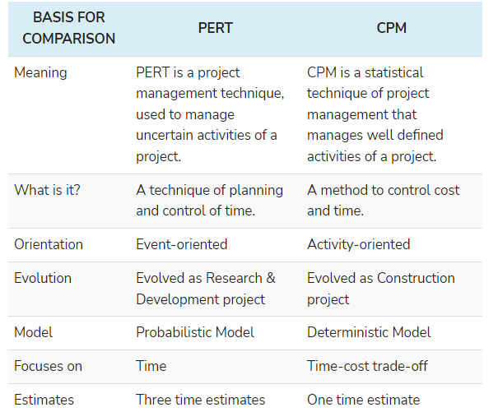
Difference between PERT and CPM

Slide 11

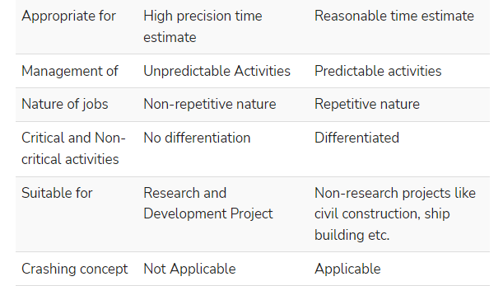

Slide 12
What is Float in Project Management?
In project management, float, sometimes also referred to as “slack,”
It is a number that indicates the amount of time a task can be delayed without impacting subsequent tasks or the project’s overall completion.
It’s important to track float when you are maintaining your project schedule.
There are two types of float in project management, free float (FF) and total float (TF).

Slide 13
Free float is the amount of time that a task can be delayed without impacting the subsequent task.
Total float is the amount of time a task or a project can be delayed without impacting the overall project completion time.
A project’s total float is the difference between the finish date of the last task on the critical path and the project completion date.
To calculate the free float of a task, simply take the difference between the next task’s planned start date, and the current task’s end date.

Slide 14
Free float (FF) is also a helpful number to monitor because it gives you a way to decide which tasks need to be prioritized and which can be pushed back to do it in a later date.
If a task has zero free float or a low free float number, then it should go to the top of the priority list so the project team can knock it out.
Conversely, any tasks with high FF numbers can be pushed to the bottom of the priority list, because there is no rush to get them finished up.

Slide 15
An example of float
Let’s assume you’re building your new kitchen, and you have 90 days to complete the process because you have a big party planned in three months. In order to complete the kitchen renovation project, the following things must happen in order:
  Drywall installation
  Cabinet installation
  Plumbing/Electric
  Floor installation
These activities make up the critical path and have zero float.

Slide 16
Then there are additional tasks like painting and decorating that need to happen, but they have much more flexibility as to when they can be done. These tasks make up the non-critical path.
Painting can be done any time after the drywall is installed, so it has a high float. Decorating can be done any time after the painting is done, so decorating has some float too.

Slide 17
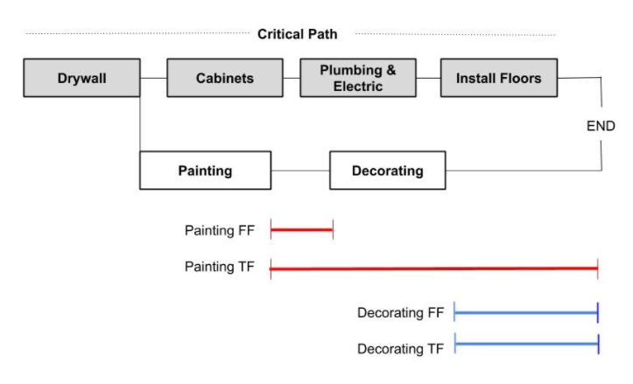

Slide 18
It might seem that float is just a technical number used in network diagrams, but it is actually a very powerful tool that can help teams learn more about their work and help improve the productivity of projects.
Monitoring a project’s total float (TF) is crucial to ensure that the overall project is going to be delivered on time. If you notice that a project’s TF is getting close to zero, it’s now crunch time to make sure the final remaining tasks are finished efficiently.
You may even need to add extra resources to help the project team finish the final tasks faster than originally planned. If the project isn’t going to finish on time, then it’s time to have a chat with your client or stakeholders to let them know that they should expect a delay.

Slide 19
Float is a key piece of the critical path method (CPM), a system used by project managers to efficiently schedule project activities.
Calculating float on your tasks and projects can be extremely valuable, but doing the calculations by hand is out of the question for most people.
Therefore the best way to get float numbers and other valuable calculations in real-time is to use professional project management software that automatically does the number crunching for you.

Slide 20
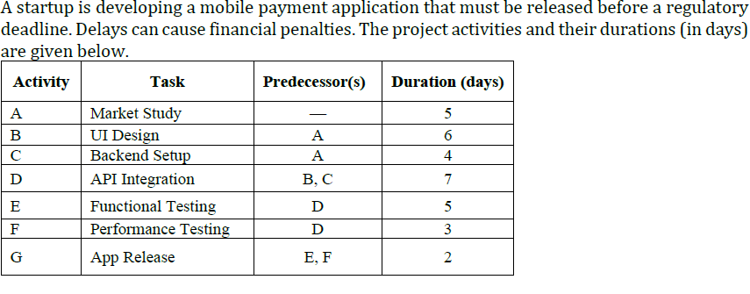



Slide 21
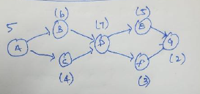

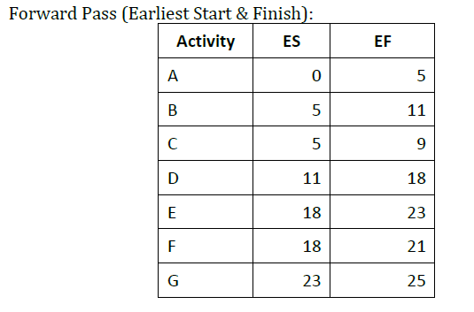
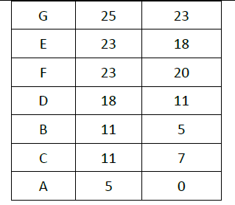

Slide 22
